Slide 1
Weekly Progress
Master thesis
Gabriel Vallat

Slide 2
27/09/22
Summary:
Stability as a DCSP
Graphical interface
Problem set-up

Slide 3
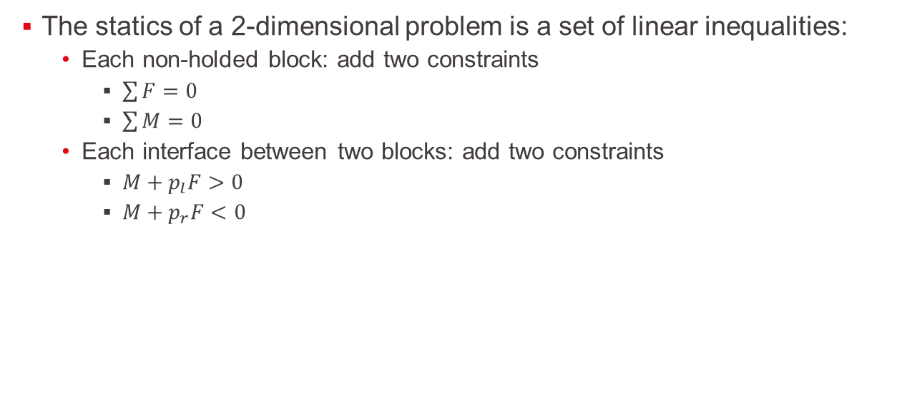
Stability as a DCSP
The statics of a 2-dimensional problem is a set of linear inequalities:
Each non-holded block: add two constraints
$\sum{F}=0$
$\sum{M}=0$
Each interface between two blocks: add two constraints
$M+p_{l}F>0$
$M+p_{r}F<0$

Slide 4
Stability as a DCSP
Example:

Slide 5
Stability as a DCSP
Example:

Slide 6
Stability as a DCSP
Linear constraints
Can be solved by several algorithms
Cassowary algorithm:
Allows to dynamically add and remove constraints.
Pure python => probably slower
Gekko:
Interface building models in binary from the constraints, using different types of solvers
Would need extensive tests, but probably faster

Slide 7
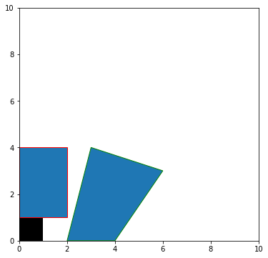
Basic plotting capabilities:
A small script allows the plotting of the blocks:

Slide 8
Problem set-up
The environment will contain:
R robots:
Actions can be:
Release a block:
Add the constraints regarding a free block to the system
Sum of forces and torque must be 0
Remove the constraints regarding the hold block
Max torque and force applied
Pick a block from a list and create interfaces at a chosen location in its range
N blocks:
A block is defined by 4 corners
It has a constant density, and its center of mass can then easily be computed
Each free block add 2 constraints to the static system
Each hold block add 2 slack constraints
Each block has at least 1 interface between either the ground or another block

Slide 9
Problem set-up
The environment will contain:
I interfaces:
The interfaces link together the side of a block with a side or corner of another block
Each interface add either 2 constraints to the system in case of side-side interface, or only 1 in case of side-corner interface
The list:
Needed to describe the possible action of the robots.
Contains a set of possible blocks that the robots can pick from, and the number of remaining block of the corresponding shape
Ideas:
The list contains exactly the right number of blocks needed for a structure
The list contains infinitely many blocks of each type

Slide 10
Problem setup
R ranges:
Each robot has only a subset of the plane accessible to lay the blocks
This range would need to be later better described, and consider the kinematic of the robot as well as the blocks already placed in the structure
For now, it will simply be a circle, with a fixed radius and centre
It could later also define the max force and torque appliable.

Slide 11
Next step:
Start to implement the constraint solver
Look into the creation of interfaces
Look into the handling of collision
Find a way to discretise the action space of the robots:
How to make it able to find placement like the following:

Slide 12
04/10/22
Interface definition
Update in simulation

Slide 13
Interface definition
3 types:
Slide
Lock
Mixed

Slide 14
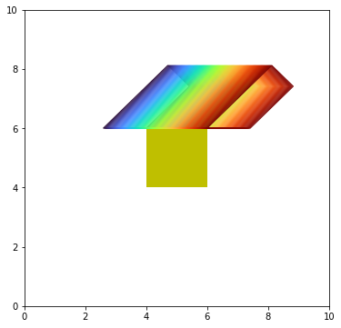
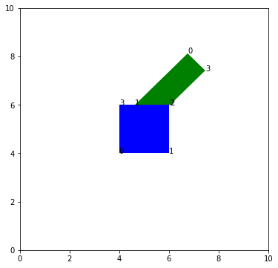
Update in simulation:
A block can be placed using a sliding interface:
Without specifying the free variable
Specifying the free variable (x=0.6)

Slide 15
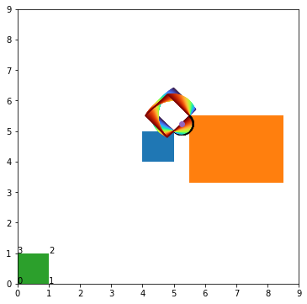
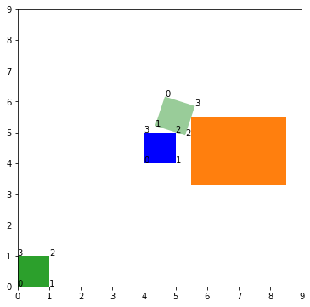
Update in simulation:
A block can be placed using a hanging interface:
This kind of interface would allow to manufacture arbitrary angles
The intersection of the blocks is much more complicated to find
Without specifying the free variable
Specifying the free variable (x=0.3)

Slide 16
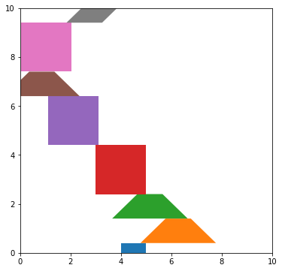
Adding the block is easy
In this scenario, the blocks come from two types and are added randomly on top of the others

Slide 17
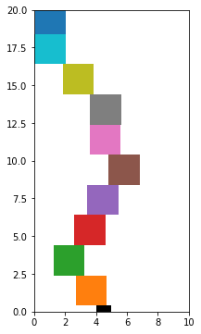
Adding the block is easy
In this one, square blocks are put on top of one another

Slide 18
Questions
Should it be possible to remove blocks?
Would the hanging interface be useful
Same question for the mixed interface
Discretization:
Clean idea:
Each action is composed of a sequence of 3 subactions:
Chose a block from the list
Chose which face to put against which face
Chose an offset: A number between 0 and 1, roughly discretized, where 0 means the new block touches an obstacle on the left and 1 means it touches an obstacle on the right
(Maybe) Problem: reduce the ability to generalize from interface to interface

Slide 19
Question about the intersection
How to handle these cases:
Discontinuous valid x

Slide 20
Next steps
Implementing the intersections of the flat surfaces
Implementing the physics in the simulation

Slide 21
11/10/22
Intersection and contact points
Discussion about the action/observation sets

Slide 22
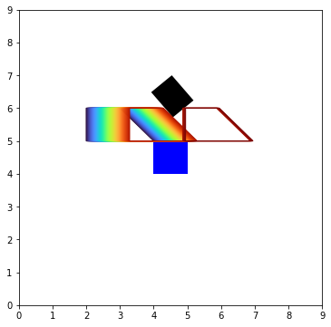
Contact points

Slide 23
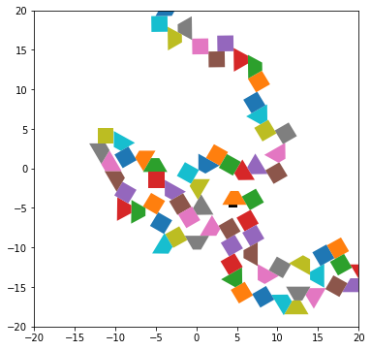
Contact points
Now the blocks does not overlap when put at random
Takes ~1s to place 100 blocks
scales in O(n²)
Without the physics
Can still be optimized by not checking for intersection with all the blocks

Slide 24
Action set
Idea: it takes 3 sub-actions to put a block
Hold or put
Chose a block
Chose two faces
Chose an offset
Chose if keep holding

Slide 25
Action set
New blocks
Idea: it takes 3 sub-actions to put a block
Start holding
Chose a block
Chose two faces
Chose an offset
Keep the block

Slide 26
Action set
New block
Idea: it takes 3 sub-actions to put a block
Chose a block
Chose two faces
Chose an offset
2
3
1
0
5
8
6
2
7
4
3
1
0

Slide 27
Action set
New block
Idea: it takes 3 sub-actions to put a block
Chose a block
Chose two (valid?) faces
Chose an offset
2
3
1
0
5
8
6
10
9
2
7
4
3
1
0

Slide 28
Action set
Idea: it takes 3 sub-actions to put a block
Chose a block
Chose two valid faces
Chose an offset:
A number between 0 and 1
X=0

Slide 29
Action set
Idea: it takes 3 sub-actions to put a block
Chose a block
Chose two valid faces
Chose an offset:
A number between 0 and 1

Slide 30
Action set
Idea: it takes 3 sub-actions to put a block
Chose a block
Chose two valid faces
Chose a (valid?) offset:
A number between 0 and 1
Without the validity check:
X=1

Slide 31
Action set
Idea: it takes 3 sub-actions to put a block
Chose a block
Chose two valid faces
Chose a (valid?) offset:
A number between 0 and 1
With the validity check:
X=1

Slide 32
Action set
About the valid offset:
An interface can have different valid regions
Leads to discontinuity
X=k
X=k+ε

Slide 33

Action set
About the valid offset:
An interface can have different valid regions
Leads to discontinuity
If x is to be discretised, might be good to add some inputs:
Formally: $x∈\left\{\frac{i}{n};i ≤n;i,n∈ℕ^{+},\right\}∪\left\{k;k+ε\right\}$
X=k
X=k+ε

Slide 34
Action set
Can be stored in a dynamic tree

Slide 35
Action set: discretised state space
Can use a triangle grid instead:
Limited in the shapes
Only 60 or 120 degrees angles are possible

Slide 36
Observation set
First point: Does the second robot knows if the first one is holding a block?
Two different amount of information:
Corners
Corners structured
(knowing which corner they are connected to)
Corners + contact points
Value of the forces applied on a block?

Slide 37
18/10/22
Switch to discrete
Triangle grid and possible scenarios
Change in equilibrium calculation

Slide 38
Switch to discrete
Problems with continuous:
Describing the actions would have been dynamic and growing linearly with the number of blocks
Each face would require to test whether or not the last action changed its parameter

Slide 39
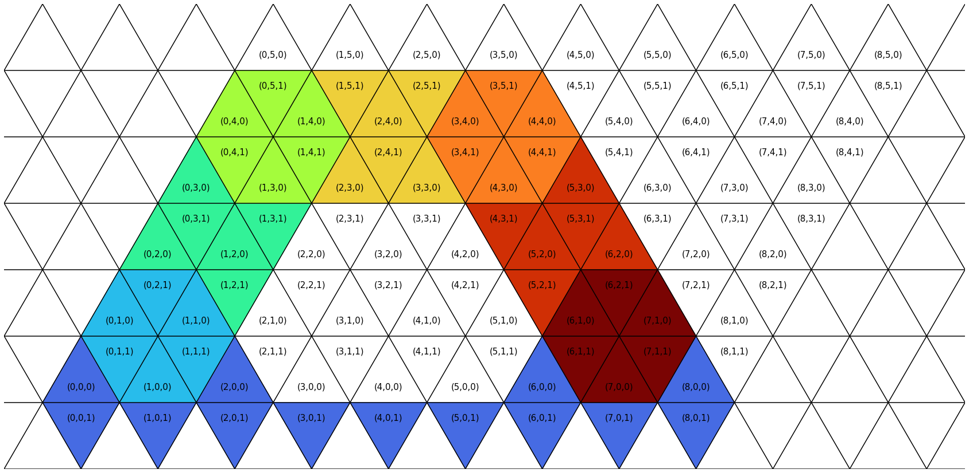

Switch to discrete
Idea: replace the quadrilateral blocks by a grid equilateral triangles
Only ${6n}_{type block}x_{max}y_{max}$ possible actions

Slide 40
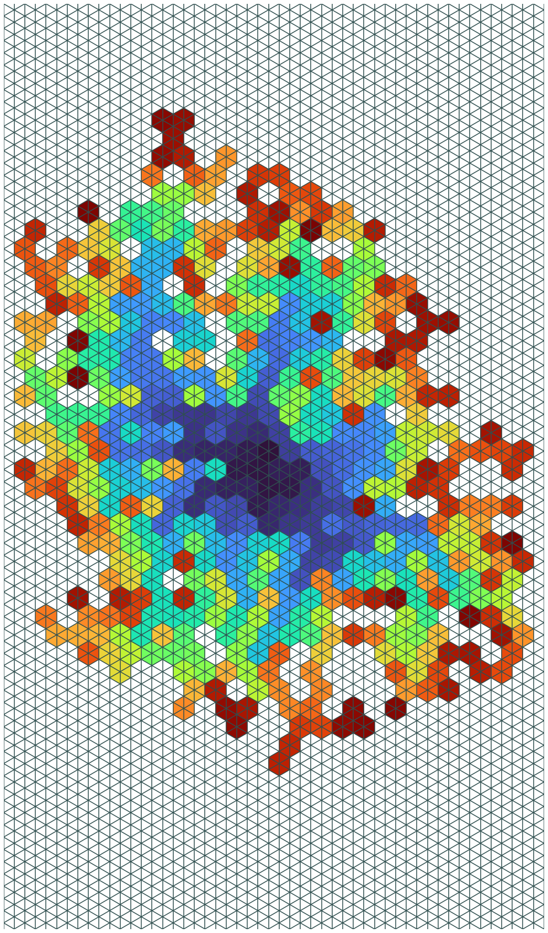
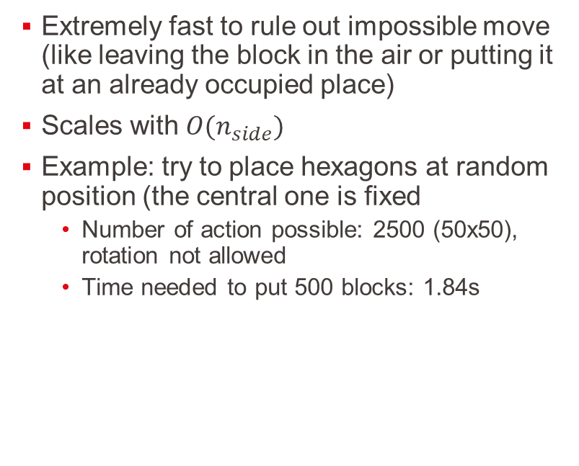
Switch to discrete
Extremely fast to rule out impossible move (like leaving the block in the air or putting it at an already occupied place)
Scales with $O(n_{side})$
Example: try to place hexagons at random position (the central one is fixed
Number of action possible: 2500 (50x50), rotation not allowed
Time needed to put 500 blocks: 1.84s

Slide 41

Possible scenarios
Use two types of blocks: hinge and link
Try to build arches with different terrains

Slide 42
Possible scenarios
Use only hexagonals
Start with a full terrain
Remove blocks so the other robot make the structure collapse

Slide 43
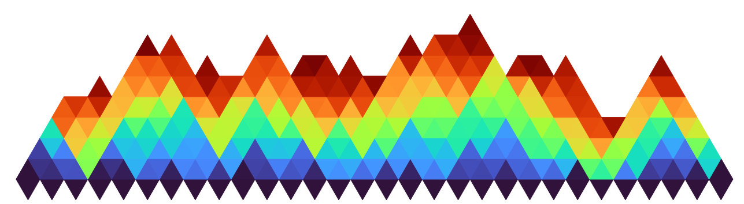
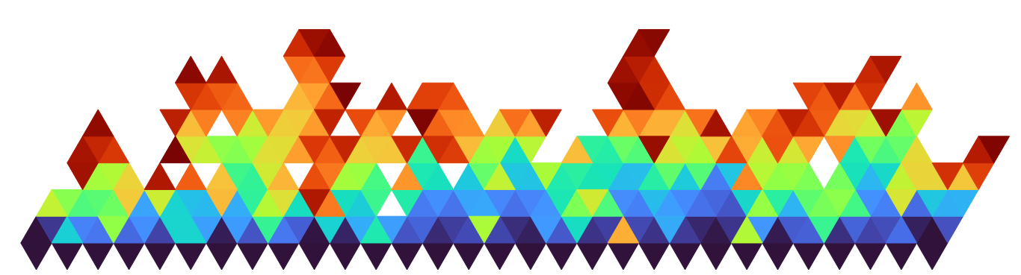
Equilibrium
Optimization library not usable:
Time taken to build the model is too long (constant 3s)
Whereas the solving time is only 0.025s
Try a non-sequential approach with SciPy:
Works quite well:
300 blocks at random on a (30x20) grid:
Take ~53s but
Put at random
Much more complicated problem to solve

Slide 44
Equilibrium results
With the equilibrium test (53s):
Without the equilibrium test (1.38s):

Slide 45
25/10/22
Game description

Slide 46
Game elements
Agents
Action set
Observation set
States
States transition
Reward
Terminal state

Slide 47
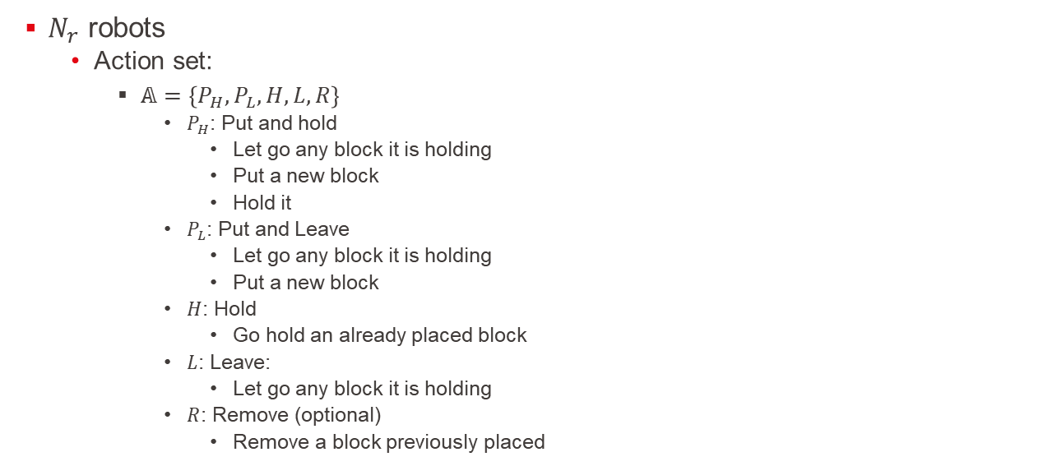
Agents
$N_{r}$ robots
Action set:
$𝔸=\left\{P_{H},P_{L},H,L,R\right\}$
$P_{H}$: Put and hold
Let go any block it is holding
Put a new block
Hold it
$P_{L}$: Put and Leave
Let go any block it is holding
Put a new block
$H$: Hold
Go hold an already placed block
$L$: Leave:
Let go any block it is holding
$R$: Remove (optional)
Remove a block previously placed

Slide 48

Agents
$N_{r}$ robots
Action set:
$𝔸=\left\{P_{H},P_{L},H,L,R\right\}$
$P_{L}$ or $P_{H}$: Put
Chose a block from a list
Chose its orientation among 6 choices
Chose the location of its reference point

Slide 49

Agents
$N_{r}$ robots
Observation set:
Consider the game as open information: $𝕆=𝕊$

Slide 50
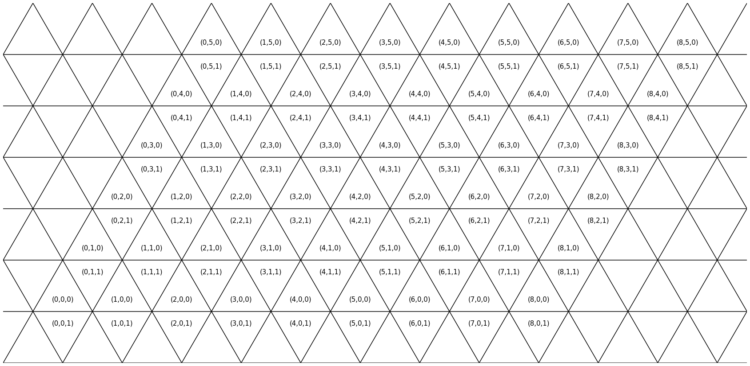

States
Grid: $𝔾=\left\{\left(x,y,d\right) ∈ℕ^{2}×\left\{0,1\right\} | 0<x<x_{max} and 0<y<y_{max}\right\}$
$x,y$: coordinates of the leftmost corner of a triangle (using isometric base)
$d$: (=down) is equal to 0 if the triangle is pointing up, 1 otherwise

Slide 51
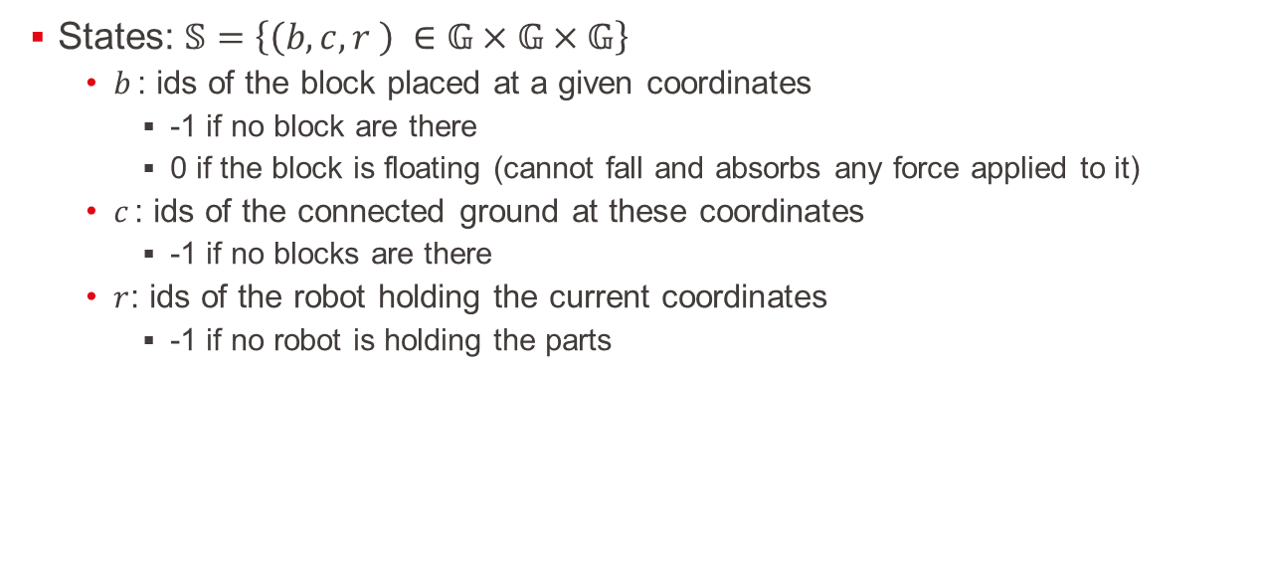
States
States: $𝕊=\left\{\left(b,c,r \right) ∈𝔾×𝔾×𝔾\right\}$
$b_{ }$: ids of the block placed at a given coordinates
-1 if no block are there
0 if the block is floating (cannot fall and absorbs any force applied to it)
$c_{ }$: ids of the connected ground at these coordinates
-1 if no blocks are there
$r_{ }$: ids of the robot holding the current coordinates
-1 if no robot is holding the parts

Slide 52
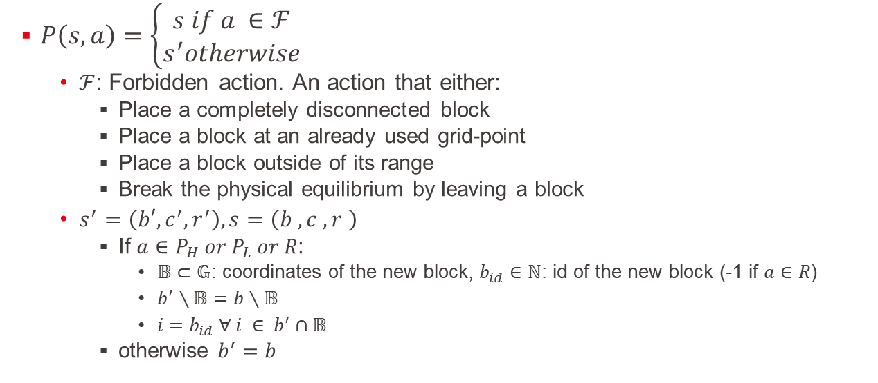
State transition
$P\left(s,a\right)=\left\{\begin{aligned}s if a ∈ℱ \\ s^{′}otherwise\end{aligned}\right.$
$ℱ$: Forbidden action. An action that either:
Place a completely disconnected block
Place a block at an already used grid-point
Place a block outside of its range
Break the physical equilibrium by leaving a block
$s^{′}=\left(b′,c_{ }^{′}, r_{ }^{′}\right),s=\left(b_{ }^{ },c_{ }^{ }, r_{ }^{ }\right)$
If $a∈P_{H} or P_{L} or R$:
$𝔹⊂𝔾$: coordinates of the new block, $b_{id}∈ℕ$: id of the new block (-1 if $a∈R$)
$b_{ }^{′}∖𝔹=b∖𝔹$
$i=b_{id} ∀ i ∈ b^{′}∩𝔹$
otherwise $b^{′}=b$

Slide 53
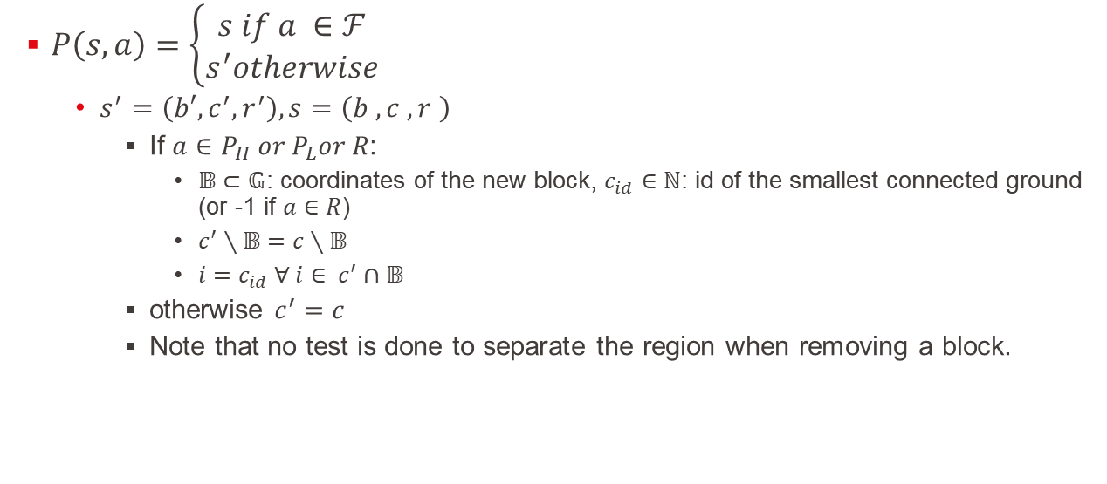
State transition
$P\left(s,a\right)=\left\{\begin{aligned}s if a ∈ℱ \\ s^{′}otherwise\end{aligned}\right.$
$s^{′}=\left(b′,c_{ }^{′}, r_{ }^{′}\right),s=\left(b_{ }^{ },c_{ }^{ }, r_{ }^{ }\right)$
If $a∈P_{H} or P_{L}or R$:
$𝔹⊂𝔾$: coordinates of the new block, $c_{id}∈ℕ$: id of the smallest connected ground (or -1 if $a∈R$)
$c_{ }^{′}∖𝔹=c∖𝔹$
$i=c_{id} ∀ i∈ c^{′}∩𝔹$
otherwise $c^{′}=c$
Note that no test is done to separate the region when removing a block.

Slide 54
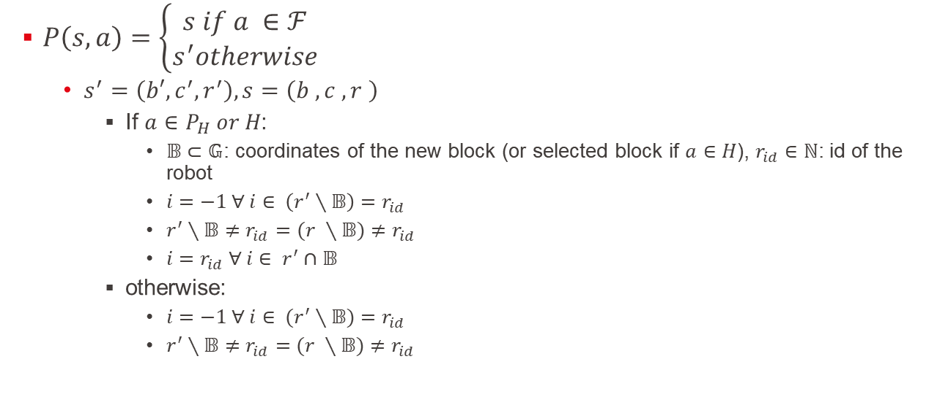
State transition
$P\left(s,a\right)=\left\{\begin{aligned}s if a ∈ℱ \\ s^{′}otherwise\end{aligned}\right.$
$s^{′}=\left(b′,c_{ }^{′}, r_{ }^{′}\right),s=\left(b_{ }^{ },c_{ }^{ }, r_{ }^{ }\right)$
If $a∈P_{H} or H$:
$𝔹⊂𝔾$: coordinates of the new block (or selected block if $a∈H$), $r_{id}∈ℕ$: id of the robot
${i=−1 ∀ i∈}_{ }^{ }\left(r^{′}∖𝔹\right)=r_{id}$
$r^{′}∖𝔹≠r_{id}=$ $(r^{ }∖𝔹)≠r_{id}$
$i=r_{id} ∀ i∈ r^{′}∩𝔹$
otherwise:
${i=−1 ∀ i∈}_{ }^{ }(r^{′}∖𝔹)=r_{id}$
$r^{′}∖𝔹≠r_{id}=(r^{ }∖𝔹)≠r_{id}$

Slide 55

Terminal state
The game ends when $i <1 ∀ i∈c$ and $j=−1 ∀j∈r$

Slide 56

Problem with the setup
Can get into deadlocks:
Only $R$ and $H$ are valid for both R1 and R2
Seems hard to get out of these positions, but always feasible
Held by R2
Held by R1

Slide 57
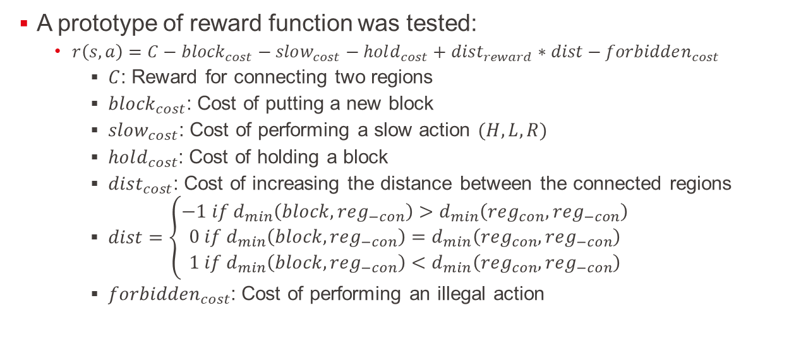
Reward function
A prototype of reward function was tested:
$r\left(s,a\right)=C−{block}_{cost}−slow_{cost}−hold_{cost}+dist_{reward}∗dist−forbidden_{cost}$
$C$: Reward for connecting two regions
$block_{cost}$: Cost of putting a new block
$slow_{cost}$: Cost of performing a slow action $(H, L, R)$
$hold_{cost}$: Cost of holding a block
$dist_{cost}$: Cost of increasing the distance between the connected regions
$dist=\left\{\begin{matrix}−1 if d_{min}\left(block,reg_{−con}\right)>d_{min}\left(reg_{con},reg_{−con}\right) \\ 0 if d_{min}\left(block,reg_{−con}\right)=d_{min}\left(reg_{con},reg_{−con}\right) \\ 1 if d_{min}\left(block,reg_{−con}\right)<d_{min}\left(reg_{con},reg_{−con}\right)\end{matrix}\right.$
$forbidden_{cost}$: Cost of performing an illegal action

Slide 58
Advances in simulation:
The discrete simulator is finished:
Animation is possible (but quite slow)

Slide 59
Animation

Slide 60
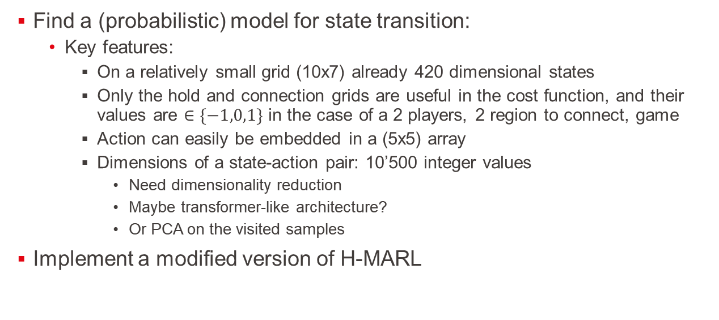
Next tasks:
Find a (probabilistic) model for state transition:
Key features:
On a relatively small grid (10x7) already 420 dimensional states
Only the hold and connection grids are useful in the cost function, and their values are $∈\{−1,0,1\}$ in the case of a 2 players, 2 region to connect, game
Action can easily be embedded in a (5x5) array
Dimensions of a state-action pair: 10’500 integer values
Need dimensionality reduction
Maybe transformer-like architecture?
Or PCA on the visited samples
Implement a modified version of H-MARL

Slide 61
31/10/22
New animation
Deep Q learning
Wolpertinger
Feedback on the literature review

Slide 62
Animation
Two formats:
HTLM
link to file
Gif

Slide 63
Deep Q learning
Composed of 2 simple parts:
A state encoder:
Take the grids and transform it into a vector
For now, it is implemented by a simple convolutional layer, that takes the ups and down as two separate channels
An action-value decoder
For a given state vector, give the value of each action
The tuples of (state-action-reward-newstate) are not shared between the agents for training

Slide 64
Deep Q learning
Train off-policy by using a replay buffer
Explore by having an optimistic Q table and choosing its actions by using softmax over them (for now)
Able to find an unforeseen solution:

Slide 65
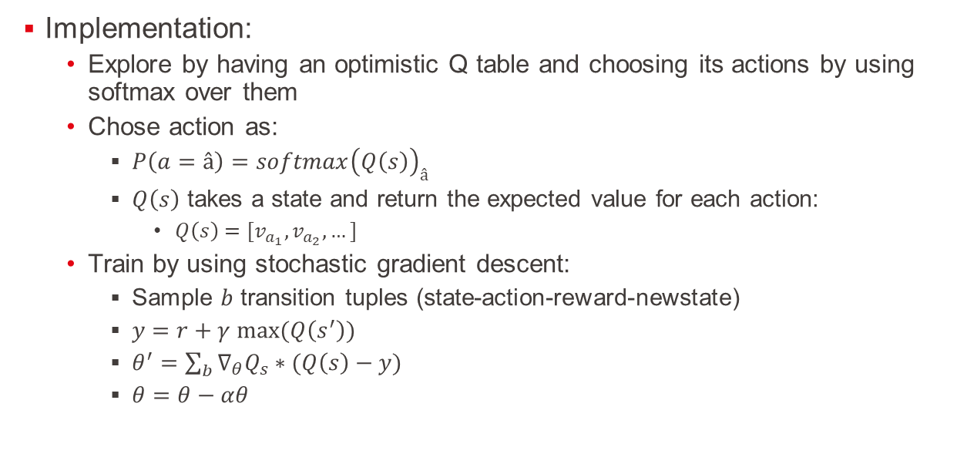
Deep Q learning
Implementation:
Explore by having an optimistic Q table and choosing its actions by using softmax over them
Chose action as:
$P\left(a=â\right)=softmax{\left(Q\left(s\right)\right)}_{â}$
$Q\left(s\right)$ takes a state and return the expected value for each action:
$Q\left(s\right)=[v_{a_{1}}, v_{a_{2}}, …]$
Train by using stochastic gradient descent:
Sample $b$ transition tuples (state-action-reward-newstate)
$y=r+γ max(Q\left(s^{′}\right))$
$θ^{′}=\sum_{b}{∇_{θ}Q_{s}∗(Q\left(s\right)−y) }$
$θ=θ−αθ$

Slide 66
Wolpertinger
Efficient algorithm when a lot of actions are possible
Apparently ~1300 actions is not enough for it to be more efficient than DeepQ
Based on deep deterministic policy gradient and actor critique model
Generate a continuous protoaction and use knn to project it on k real actions, then select one using softmax over these
Still need to figure out the value of several hyperparameters

Slide 67
Feedback on literature review
a self-supporting structure is an assembly of rigid components that do not require any binder to connect the parts, and that stays in static equilibrium through gravity-induced compression forces that immobilize all the parts
graph of connected blocks
stacking a block on top of another is the same task if the first block is on the ground or already on top of a tower. As this assumption is hardly true in our case
They only cared about vertical stacking, so the statics of the blocks below the last one can be ignored

Slide 68
Feedback on literature review
[An agent] knows for sure its own action, and the ones of the other agents [are modelled as stochastics perturbations]
Central planning and decentralized execution
Q-learning ok for 2 agents
Number of local minima/saddle point increasing? can we them with equations/justification?
Paper from Jan Peters

Slide 69
Next steps
Small modification on the reward function
Need to equilibrate the parameters
Finishing the implementation of Wolpertinger:
Need a good exploration method, as softmax is not enough
Export the gym to a jupyter notebook to better control the experiments

Slide 70
15/11/22
State description
Single agent settings
Change in the action space

Slide 71
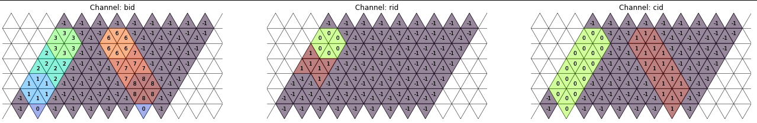
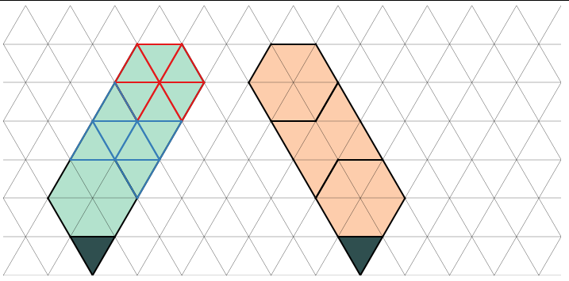
Simulator state description

Slide 72
Single agent
A single agent model was implemented
Would ideally be used as a baseline in the long term
Avoid some questions about the rewards strategy for now

Slide 73
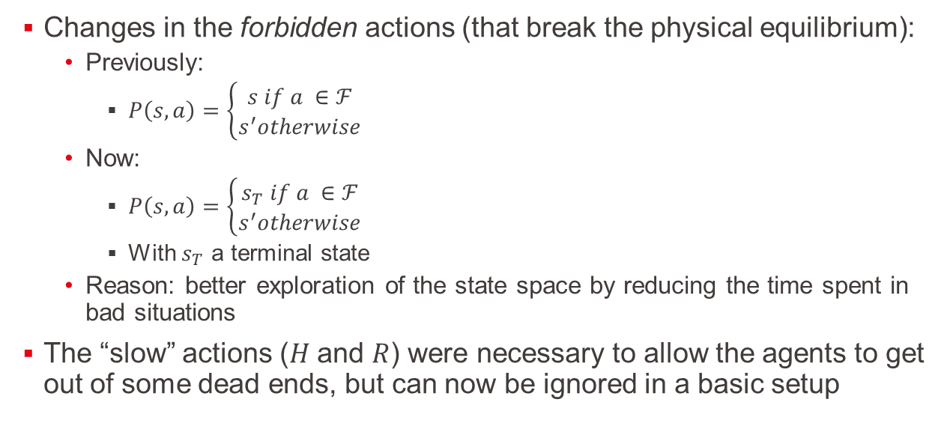
Change in the action space
Changes in the forbidden actions (that break the physical equilibrium):
Previously:
$P\left(s,a\right)=\left\{\begin{aligned}s if a ∈ℱ \\ s^{′}otherwise\end{aligned}\right.$
Now:
$P\left(s,a\right)=\left\{\begin{aligned}s_{T} if a ∈ℱ \\ s^{′}otherwise\end{aligned}\right.$
With $s_{T}$ a terminal state
Reason: better exploration of the state space by reducing the time spent in bad situations
The “slow” actions ($H$ and $R$) were necessary to allow the agents to get out of some dead ends, but can now be ignored in a basic setup

Slide 74
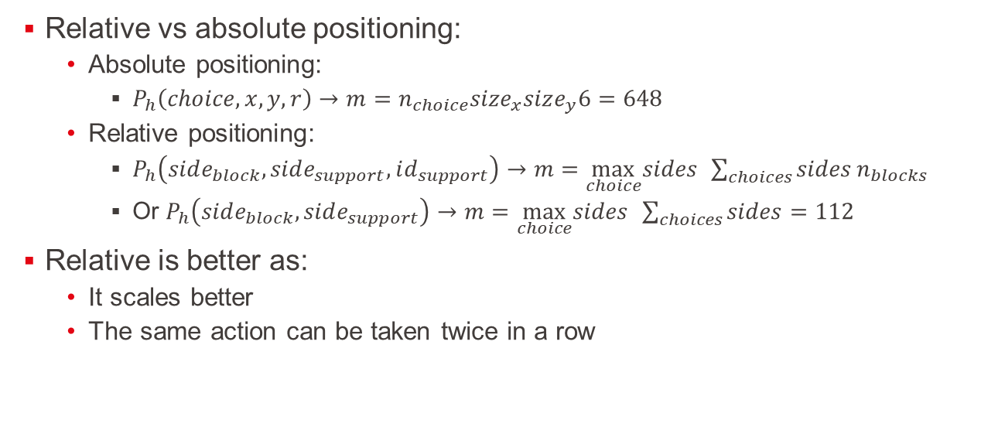
Change in the action space
Relative vs absolute positioning:
Absolute positioning:
$P_{h}\left(choice,x,y,r\right)→m=n_{choice}size_{x}size_{y}6=648$
Relative positioning:
$P_{h}\left(side_{block},side_{support},id_{support}\right)→m=\max_{choice}sides{ }\sum_{choices}{sides}n_{blocks}$
Or $P_{h}\left(side_{block},side_{support}\right)→m=\max_{choice}sides{ }\sum_{choices}{sides}=112$
Relative is better as:
It scales better
The same action can be taken twice in a row

Slide 75
Thoughts about a less sequential Markov game
Until now, the multi-agent setting was done in a sequential way
Does not utilize fully both the robot capabilities and the Markov game framework
Idea:
Each agent act simultaneously:
The physical equilibrium is checked after all the agents performed their actions
Some actions can force an agent to go in a “busy” state for a few rounds
Pick a block, dispose of a block, …
Open questions:
Symmetry of the game: should each agent be treated fairly
What happens when an action fails

Slide 76
Thoughts about a more general setup
Until now, the initial state was always the same
Idea:
Randomly chose the targets to link in the grid
This would allow a potentially better learning curve (some targets would be easy to reach, some more difficult)

Slide 77
22/11/22
Construction as a graph
Access to GPU/cloud computing

Slide 78
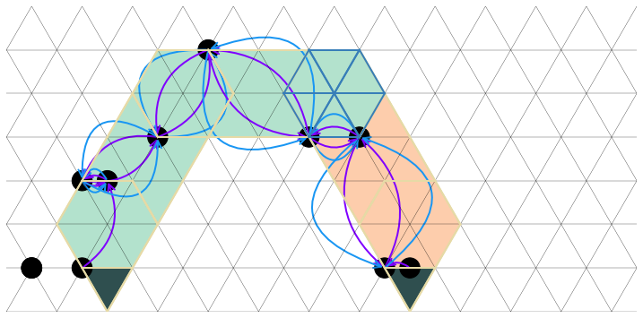
Construction as a graph
The setup can be seen as a directed and attributed multigraph:
Directed: each edge goes from a node to another
Attributed: A vector component is attached to each node and edge
Multigraph: 2 nodes can be connected by more than one edge

Slide 79
Construction as a graph
Each block is a node in the graph
Its attribute is a 5 dimensional natural vector containing:
Block type
Holder id
X position
Y position
Rotation
Each edge represent a potential support
Its attribute is a single integer:
The side id of receiving node

Slide 80
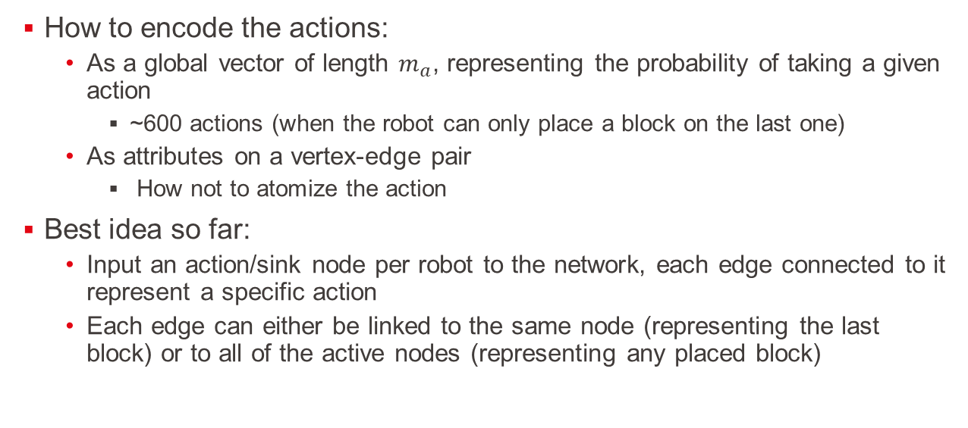
Construction as a graph
How to encode the actions:
As a global vector of length $m_{a}$, representing the probability of taking a given action
~600 actions (when the robot can only place a block on the last one)
As attributes on a vertex-edge pair
How not to atomize the action
Best idea so far:
Input an action/sink node per robot to the network, each edge connected to it represent a specific action
Each edge can either be linked to the same node (representing the last block) or to all of the active nodes (representing any placed block)

Slide 81
Implementation open problem
The number of edges/node in a state is dynamic
Batches are extracted from the replay memory buffer: three possibilities
Unbatch the input
Consider that disconnected edges/nodes might be useful in some way
Mask out the influence of the disconnected edges/nodes

Slide 82
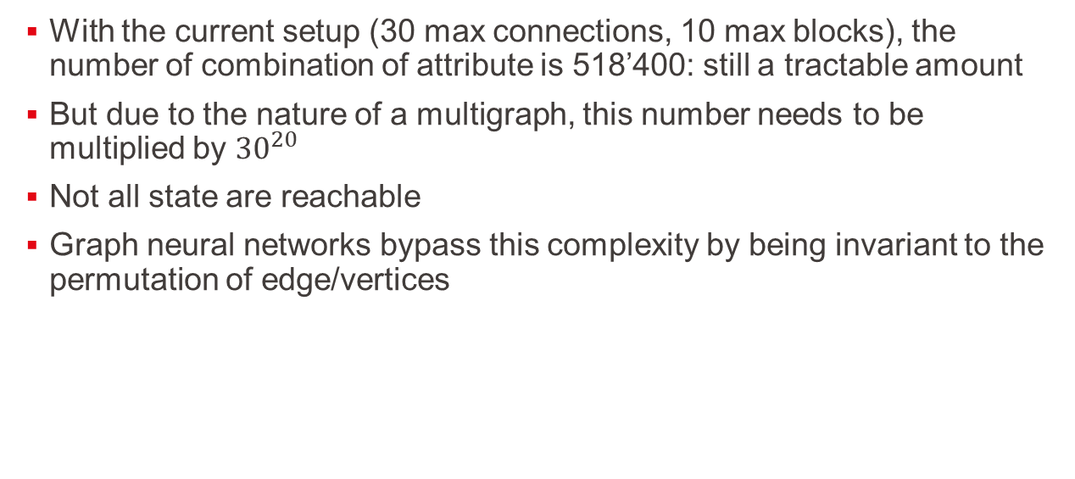
State size:
With the current setup (30 max connections, 10 max blocks), the number of combination of attribute is 518’400: still a tractable amount
But due to the nature of a multigraph, this number needs to be multiplied by ${30}^{20}$
Not all state are reachable
Graph neural networks bypass this complexity by being invariant to the permutation of edge/vertices

Slide 83
Access to cloud computing
Several training hyperparameters need to be tuned:
Learning rates
Model size
Normalization
...
Could I access the cloud computing facility of the EPFL?

Slide 84
Next step
Finish the implementation of a graph neural network
Find working hyperparameters

Slide 85
29/11/22
Working on cloud
GNN implemented
Metrics

Slide 86
Cloud computing
Faster computing time
Can test several different hyper parameters automatically using a bayes search
No hyperparameters increased significantly the results for the image-based state

Slide 87
GNN
State represented by a graph that get encoded a few times:

Slide 88
GNN
State represented by a graph that get encoded a few times:
G

Slide 89
GNN
Action represented by edges between the last node and a new node:
G

Slide 90
GNN
Action represented by edges to a new node:
G

Slide 91
GNN
Observation so far:
Slower than the image encoder (takes around 6 hours on the cluster)
Still requires hyperparameter tuning

Slide 92
Metrics
What to look at when training a model:
Reward
Policy entropy
Loss from actor and critique
Estimated V-value

Slide 93
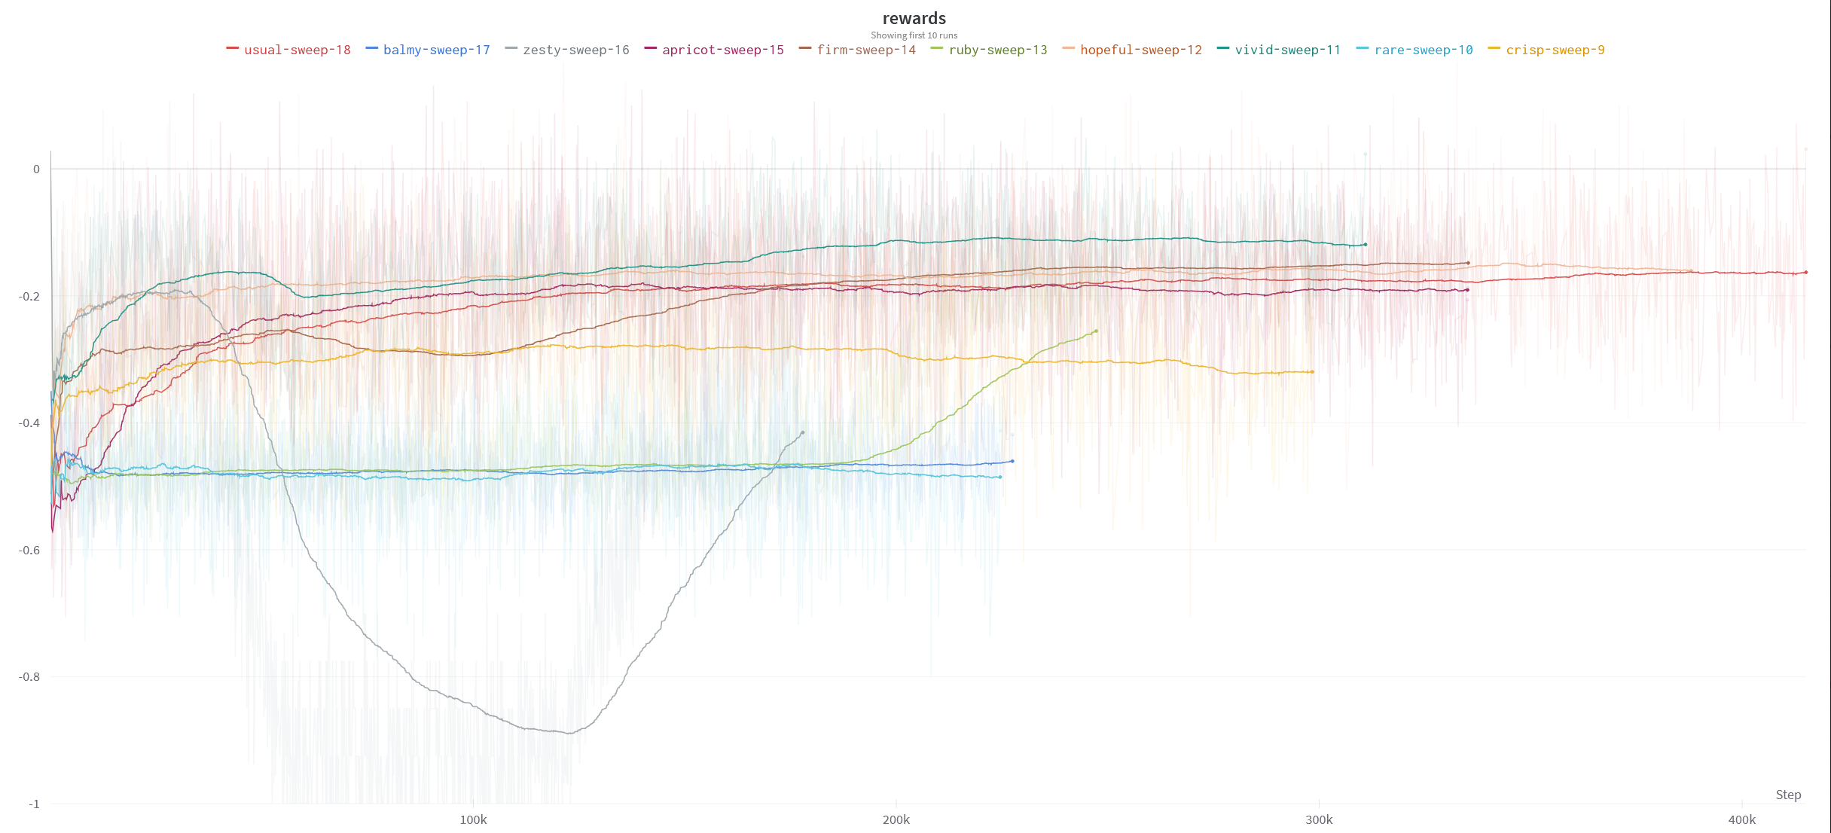
Metrics

Slide 94
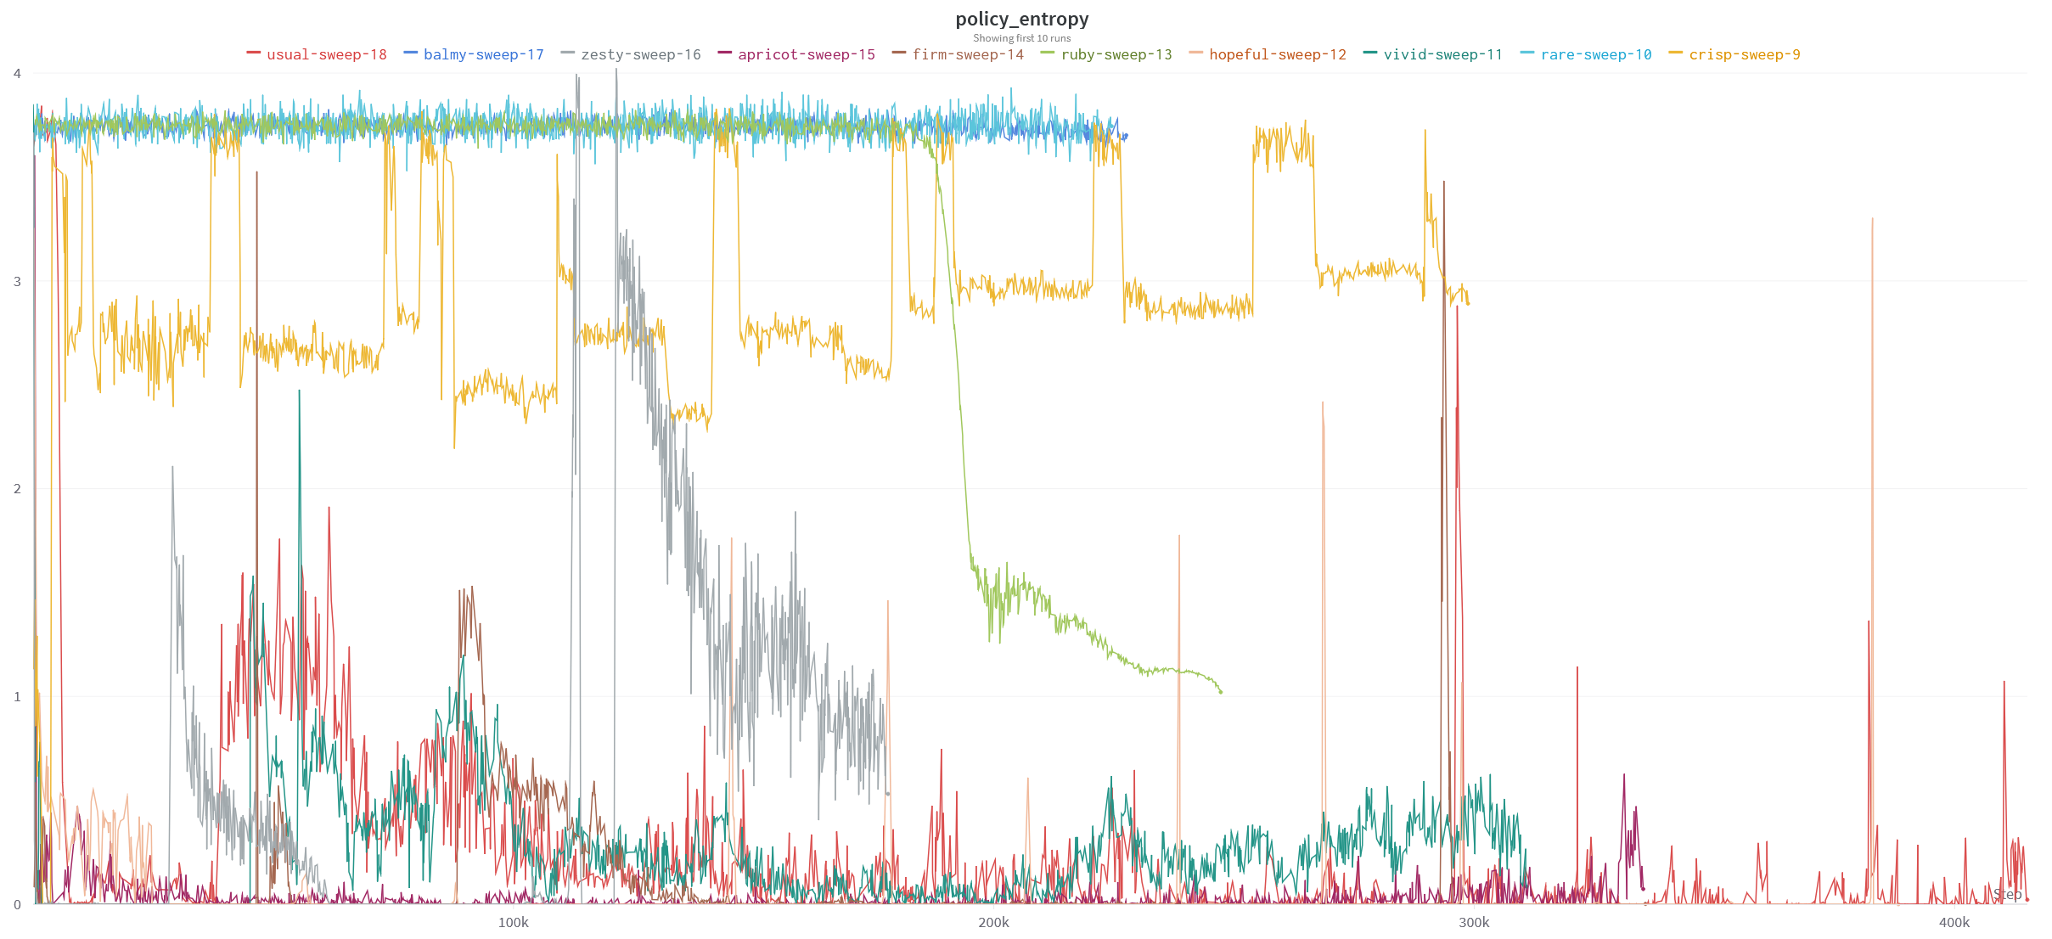
Metrics

Slide 95
Metrics

Slide 96
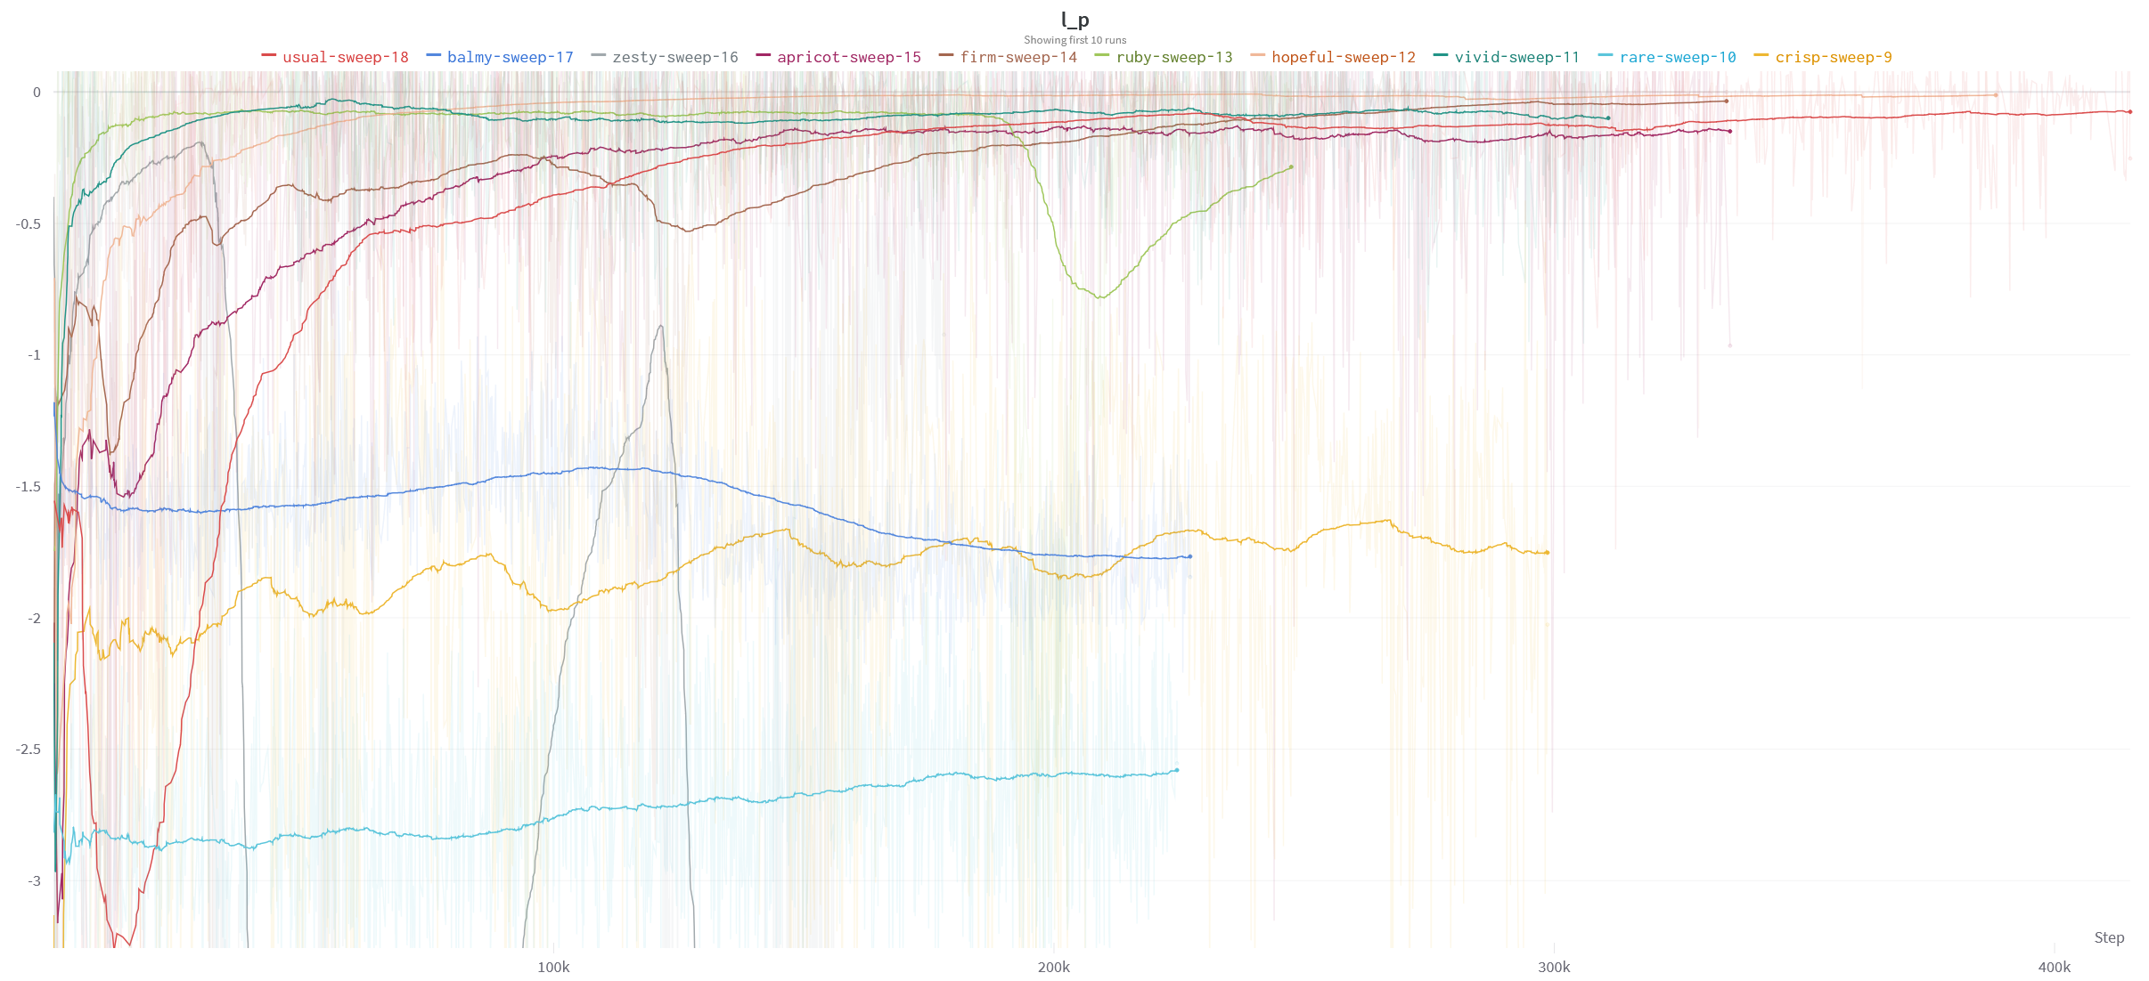
Metrics

Slide 97
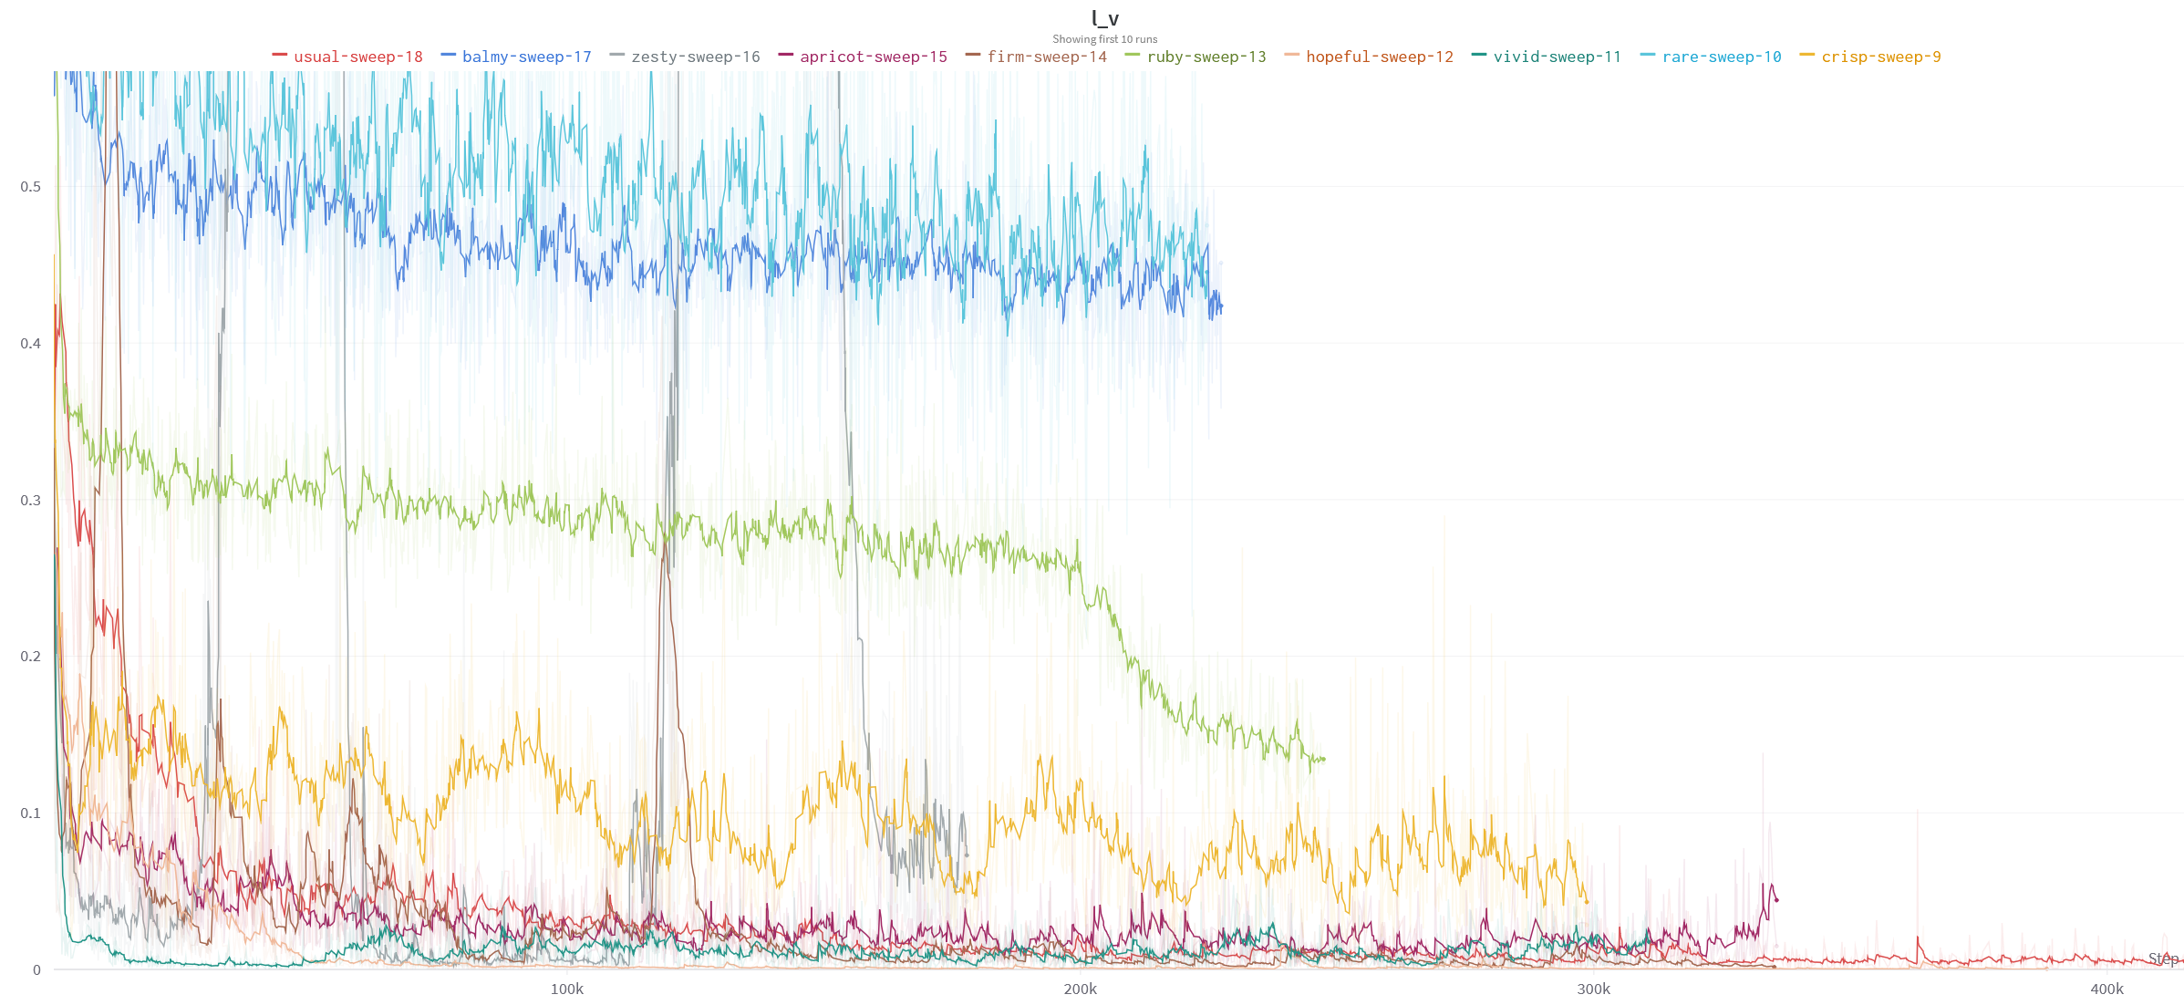
Metrics

Slide 98
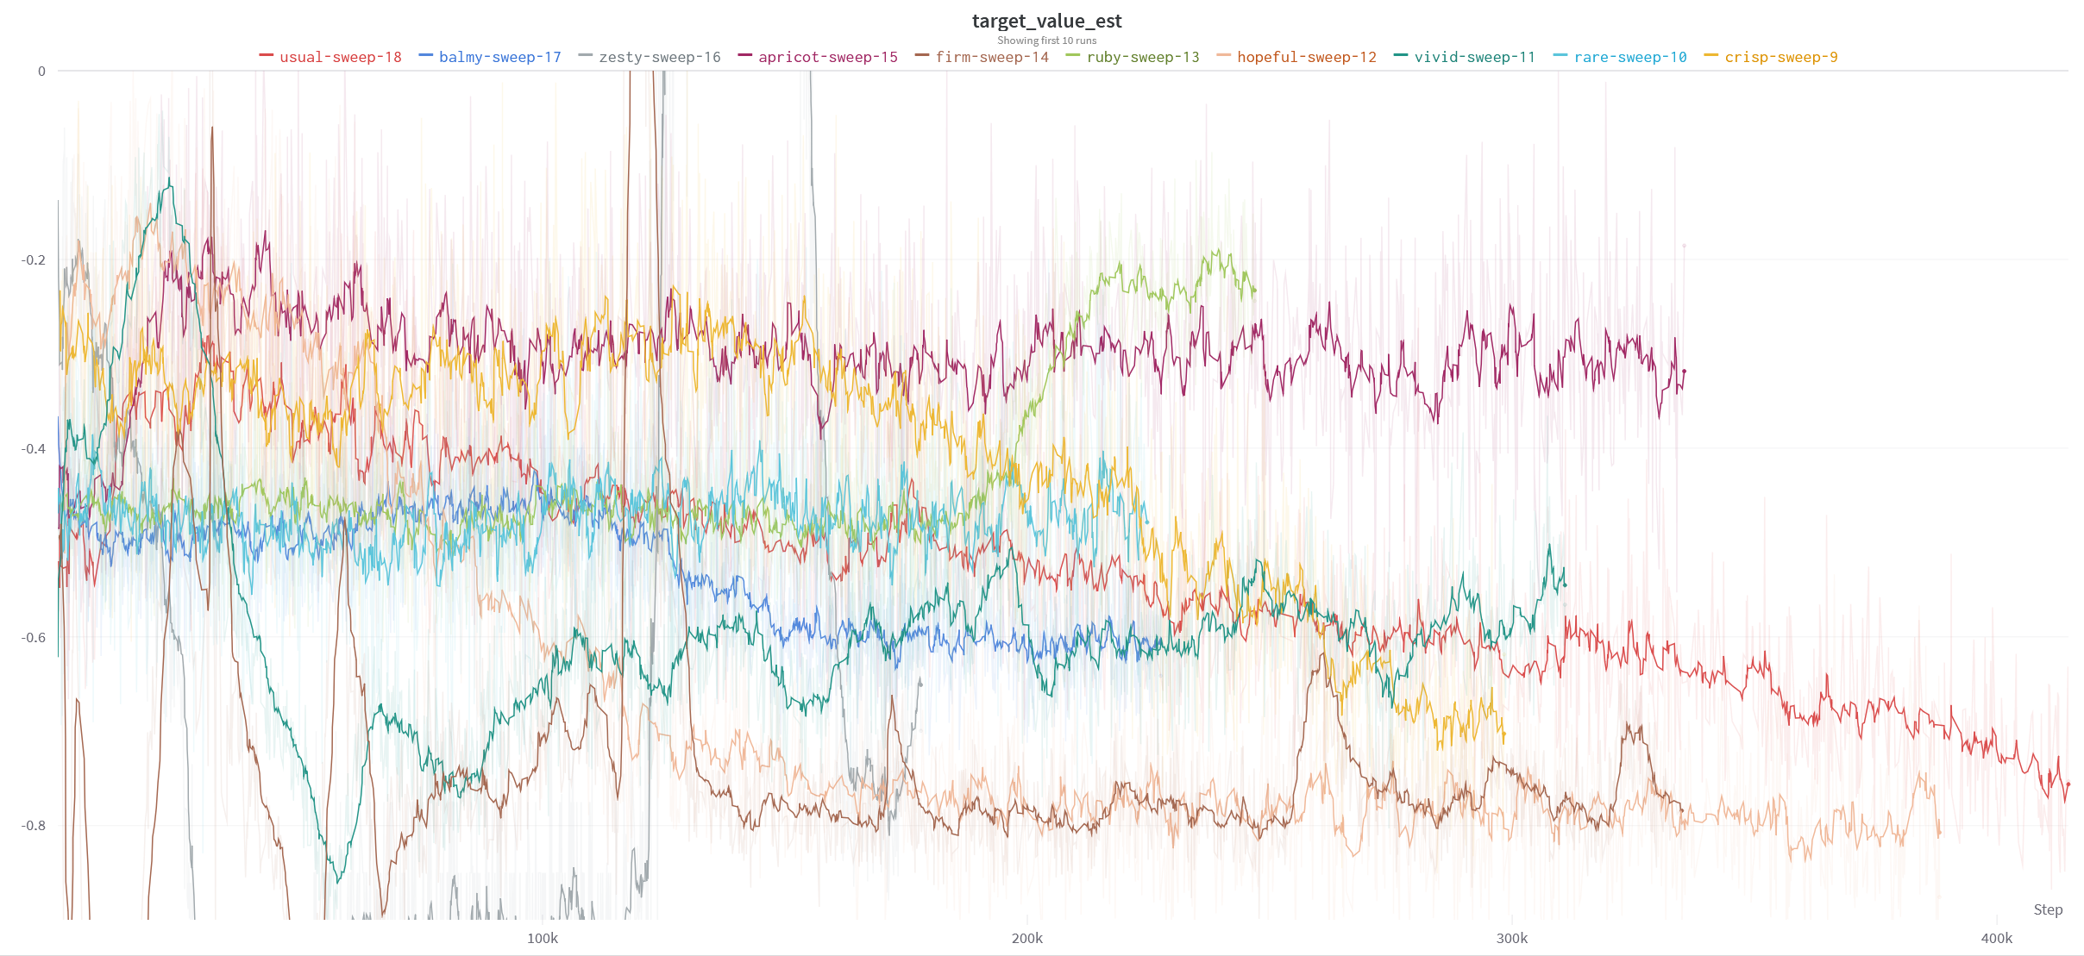
Metrics

Slide 99
Metrics

Slide 100
Next steps
Try several hyper parameters with the GNN
Try to improve the speed of the network
Start to format the report

Slide 101
06/12/22
GNN
More about the algorithm
Report
Next steps

Slide 102
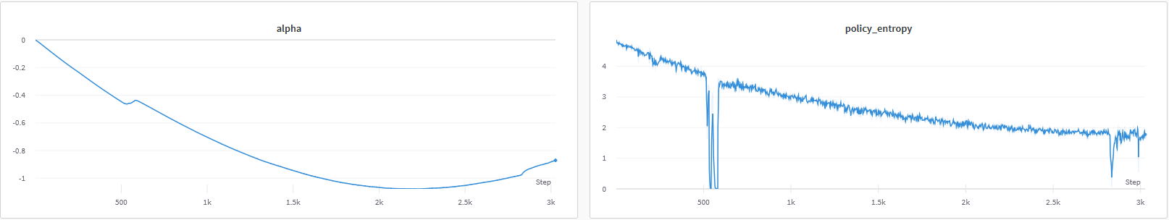
GNN
Obtain no significant improvement in the rewards
Better control of the other variables
Control of the policy entropy by using a dynamic factor and a target entropy

Slide 103
Algorithms
Current algorithm: Discrete soft actor critique (DSAC)
Continuous SAC is the current state of the art for continuous action-set
Several method had to be used to adapt it to the discrete case. Mainly:
Adding a penalty if the policy entropy is far from the one at the time the action was sampled
Clipping the Q-values if they change to fast
Uses a replay buffer
No prioritizing
Off-policy
Use softmax to select the action

Slide 104
Algorithms
Current algorithm: Discrete soft actor critique (DSAC)
Continuous SAC is the current state of the art for continuous action-set
Several method had to be used to adapt it to the discrete case. Mainly:
Adding a penalty if the policy entropy is far from the one at the time the action was sampled
Clipping the Q-values if they change to fast
Uses a replay buffer
No prioritizing
Off-policy
Use softmax to select the action

Slide 105
Algorithms
Actor critics method are not well developed for discrete action sets:
Deep Q networks and epsilon greedy policy seem to do most of the work
Highly task dependent

Slide 106
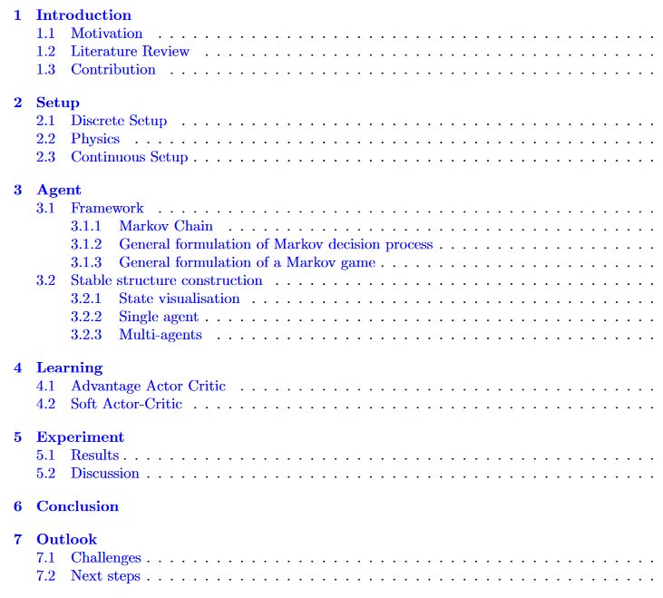
Report
The report structure would look like:

Slide 107
Next steps
Less than 2 months left:
Focus on perfectioning the current setup
Focus on the continuous cases
Focus on the multi-agent setup
Focus on the current setup
Add targets
Add robots
Add obstacles
Remove the symmetry from the actions

Slide 108
13/12/22
Working algorithm
Modification to the reward
Safety kernel

Slide 109
Working algorithm
Problem with the previous approach:
The orientation of the block had a massive effect on the action result
Destabilize learning
Action “link side 4 to side 1”
2
1
6
3
5
4
1
3
2
6
4
2
3
5
5
1
3
4
6
4
2
5
1
6

Slide 110
Working algorithm
New approach:
No rotation
A different action for each block type
“Link side 1 to side 4” is using two different depending wether the support block is a link or an hexagon
Advantage:
The result of an action is less dependent on the state
Disadvantage:
One big matrix multiplication before
the masking operation
Actions available:
Link side 1 to side 4
Link side 2 to side 5
Link side 3 to side 6
Link side 4 to side 1
Link side 5 to side 2
Link side 6 to side 3
1
2
1
2
6
6
3
5
3
5
4
4

Slide 111
More specification
The image representation was reused:
Less potential failure point
Faster training due to hardware optimization

Slide 112
Modifiaction to the reward
Before:
The robot gets
A reward of 0.4 whenever it places a block toward its target
A reward of 0 if the block is placed toward the opposite direction
A reward of 0.2 if the block is placed tangentially
A penalty of -0.1 for leaving the block
A penalty of -1 for collapsing the structure
A reward of 1 for linking the two targets and leaving

Slide 113
Modifiaction to the reward
Now:
The robot gets
A reward of 0.4 whenever it places a block toward its target
A reward of -0.4 if the block is placed toward the opposite direction
A reward of 0 if the block is placed tangentially
A penalty of -0.1 for leaving the block
A penalty of -1 for collapsing the structure
A reward of 1 for linking the two targets and leaving

Slide 114
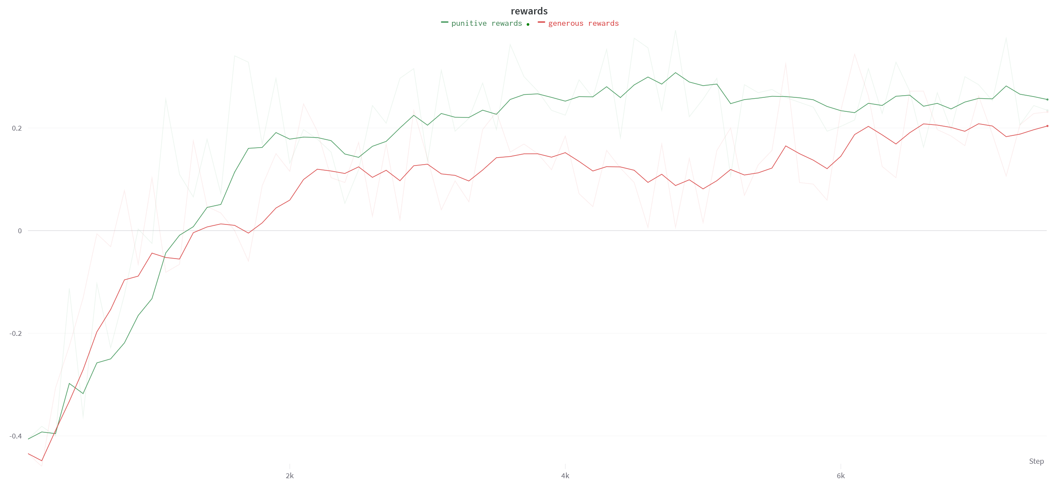
Modifiaction to the reward
Generous:
Animation
Punitive:
Animation

Slide 115
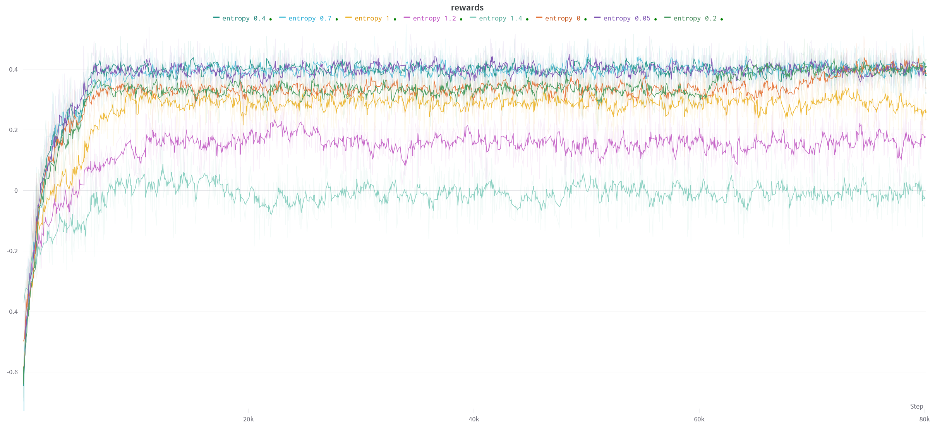
Test with the entropy target
Entropy to high
Entropy to low?

Slide 116
Safety kernel
Some unstable equilibrium could be used:
Equilibrium
No equilibrium

Slide 117
Safety kernel
Solution: A safety kernel
The force cannot be applied to close to the corners

